Slide 1


Prestige Institute of Engineering and Management Research,Indore
System for Environment Navigation using Snapshots and Exploration

Slide 2
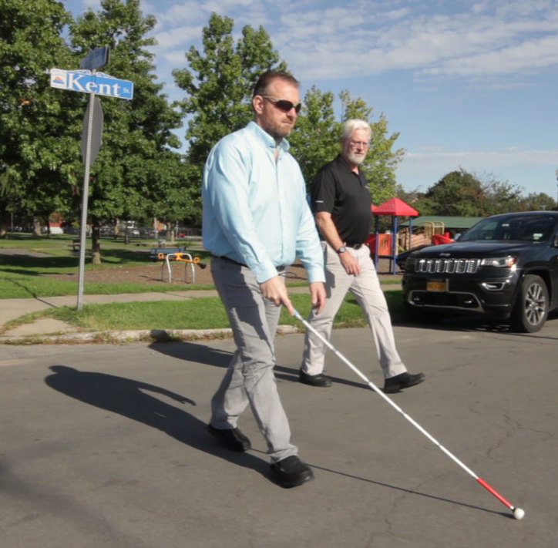
Problem statement
Visually impaired individuals encounter obstacles in navigating and identifying objects independently. Traditional aids like white canes offer limited information. An advanced vision assistance system is crucial to improve their independence, safety, and quality of life.

Slide 3
objective
Dire need for visually impaired people to navigate their life more easily.
Need for information regarding objects around them with which they can interact.
Need for a fast and efficient object detection/recognition for the purpose.

Slide 4
Solution
Idea/approach
Use YOLO library and CNNs for fast and accurate object detection and recognition.
Integrate with wearable devices to capture surroundings and provide audio feedback.
Create a user-friendly interface with voice commands and tactile inputs.
Provide real-time alerts for obstacles and hazards.
Implement continuous learning for improved object recognition over time.

Slide 5



Technology stack
Python
YOLO (You only look Once)
Open CV
Convolution neural network (CNN)

Slide 6
Use cases & future scope
Outdoor Navigation: Navigate streets and parks with real-time obstacle alerts.
Indoor Wayfinding: Identify elevators and entrances for seamless indoor navigation.
Grocery Shopping: Locate items on shelves independently while shopping.
Public Transportation: Access bus numbers and train platforms for easy commuting.
Social Interactions: Recognize faces and expressions for improved social interactions.

Slide 7
Team members
mentor
Mohammad Bilal Khan Branch : CSE
Ruchita Rani Branch : CSE
Chandra Shekhar Kushwaha Branch : AIDS
Avni Verma Branch : AIDS
Dr. Naveen R Shahi

